Slide 1

Noida Institute of Engineering and Technology, Greater Noida
Backtracking and Branch and Bound
Unit: 4
Adnan Naseem
Assistant Professor CSE (AIML)
Data Structure and Algorithm-II
B Tech 3th Sem

Slide 2
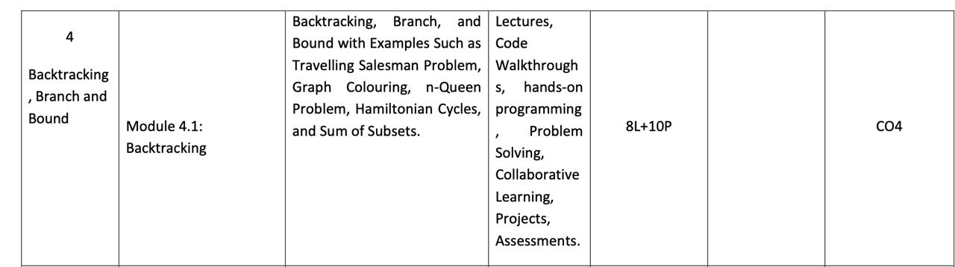
Syllabus

Slide 3
Branch and Bound
Travelling Salesman Problem
Given a set of cities and distance between every pair of cities, the problem is to find the shortest possible tour that visits every city exactly once and returns to the starting point.
In Branch and Bound method, for current node in tree, we compute a bound on best possible solution that we can get if we down this node.
If the bound on best possible solution itself is worse than current best (best computed so far), then we ignore the subtree rooted with the node.

Slide 4
Branch and Bound
Travelling Salesman Problem
Note that the cost through a node includes two costs.
1) Cost of reaching the node from the root (When we reach a node, we have this cost computed)
2) Cost of reaching an answer from current node to a leaf (We compute a bound on this cost to decide whether to ignore subtree with this node or not).

Slide 5

Branch and Bound
Travelling Salesman Problem- Example
In this method we expand the node which is most promising means the node which promises that expanding or choosing it will give us the optimal solution.
So we prepare the tree starting from root then we expand it.
The cost matrix is defined by
C(i,j) = W(i,j) , if there is a direct path from Ci to Cj.
= $∞$, If there is no direct path from Ci to Cj.

Slide 6
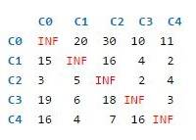
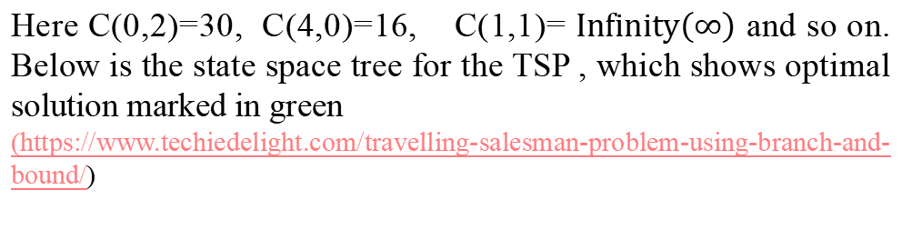
Branch and Bound
Travelling Salesman Problem- Example
Consider the following cost matrix
Here C(0,2)=30, C(4,0)=16, C(1,1)= $Infinity\left(∞\right)$ and so on. Below is the state space tree for the TSP , which shows optimal solution marked in green
(https://www.techiedelight.com/travelling-salesman-problem-using-branch-and-bound/)

Slide 7
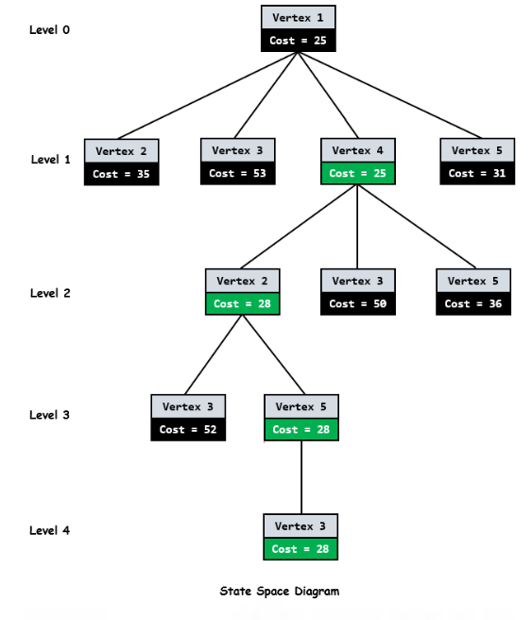
Branch and Bound
.

Slide 8
Branch and Bound
Travelling Salesman Problem- Steps
As we can see from above diagram , every node has a cost associated to it.
When we go from city I to city j, cost of a node j will be sum of cost of parent node I, cost of the edge (I,j) and lower bound of the path starting at node j.
As root node is the first node to be expanded , it doesn’t have any parent. So cost will be only lower bound of the path starting at root.
To get the lower bound of the path starting from the node , we reduce each row and column in such a wat that there must be atleast one zero in each row and column.
.

Slide 9
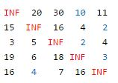
Branch and Bound
.
For doing this, we need to reduce the minimum value from each element in each row and column.
Let’s start from root node
We reduce the minimum value in each row from each element in that row.
Minimum in each row of cost matrix M is marked by blue[10,2,2,3,4] below.

Slide 10
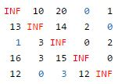
Branch and Bound
.
After reducing the row, we get the below matrix. We then reduce the minimum value in each column from each element in that column.
Minimum in each column is marked by blue[1 0 3 0 0]. After reducing the column, we get below reduced matrix. This matrix will be further processed by child nodes of root node to calculate their lower bound.

Slide 11
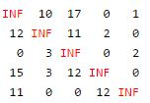
Branch and Bound
.
The total expected cost at the root node is sum of all reductions.
Cost=[10 2 2 3 4] + [1 0 3 0 0]= 25
Since we have discovered the root node C0, the next node to be expanded can be any node from C1,C2, C3, C4. Whichever node has minimum cost, that node will be expanded further. So we have to find out the expanding cost of each node.

Slide 12
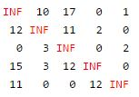
Branch and Bound
The parent node (C0) has below reduced matrix-
Let us consider edge from 0→ 1
As we are adding edge (0,1) to our search space, we get outgoing edges for city 0 to infinity and all incoming edges to city 1 to infinity. We also set (1,0) to infinity.
So in reduced matrix of parent node we change all the elements in
row 0 and column 1 and at index (1,0) to infinity(marked in red).
.

Slide 13
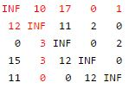
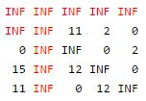
Branch and Bound
.
The resulting cost matrix is

Slide 14
Branch and Bound
.
3. We try to calculate lower bound of the path starting at node 1 using above resulting cost matrix.
4. The lower bound is 0 as matrix is already in reduced form. i.e. all rows and all columns have zero value.
Therefore for node 1, cost will be
Cost= cost of node 0 + cost of the edge (0,1) + lower bound of the
path starting at node 1
= 25 + 10 +0= 35

Slide 15
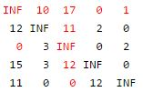
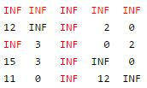
Branch and Bound
.
Change all the elements in row 0 and column 2 and at index(2,0) to infinity(marked in red).
The resulting cost matrix is:
Lets consider edge from 0→ 2

Slide 16
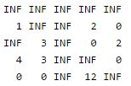
Branch and Bound
Now calculate lower bound of the path starting at node 2 using the
Approach discussed earlier. Resulting matrix will be-
Therefore the cost of node 2, cost will be
Cost = Cost of node 0 + cost of the edge (0,2) + Lower bound of the
path starting at node 2
= 25 + 17 + 11= 53

Slide 17
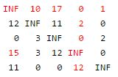
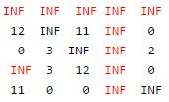
Branch and Bound
Let us consider edge from 0→ 3
Change the elements in row 0 and column 3 and at index(3,0) to
Infinity(marked in red).
The Resulting cost matrix is :

Slide 18
Branch and Bound
Now calculate lower bound of the path starting at node 3 using the
Approach discussed earlier.
Lower bound of the path starting at node 3 is 0 as it is already in reduced form, i.e. all rows and all columns have zero value.
Therefore for node 3, cost will be
Cost = Cost of node 0 + cost of the edge (0,3) + Lower bound of the
path starting at node 3
= 25 + 0 + 0= 25
Similarly we calculate for 0→ 4. Its cost will be 31.

Slide 19
Branch and Bound
Now we find a live node with estimated cost. Live nodes 1,2,3 and 4 has costs 35, 53, 25 and 31 respectively.
The minimum among them is node 3 having cost 25. So node 3 will be expanded further as shown in state space tree diagram.
After adding its children to list of live nodes, we again find a live node with least cost and expand it.
We continue the search till a leaf is encountered in space search tree. If a leaf is encountered, then the tour is completed and we will return back to the root node.

Slide 20
Backtracking (CO4)
Backtracking is an algorithmic-technique for solving problems recursively by trying to build a solution incrementally, one piece at a time, removing those solutions that fail to satisfy the constraints of the problem at any point of time.
It is a technique based on algorithm to solve problem. It uses recursive calling to find the solution by building a solution step by step increasing values with time.
It removes the solutions that doesn't give rise to the solution of the problem based on the constraints given to solve the problem.

Slide 21
Backtracking
Backtracking algorithm is applied to some specific types of problems.
  Decision problem used to find a feasible solution of the problem.
  Optimisation problem used to find the best solution that can be applied.
  Enumeration problem used to find the set of all feasible solutions of the problem
In backtracking problem, the algorithm tries to find a sequence path to the solution which has some small checkpoints from where the problem can backtrack if no feasible solution is found for the problem.

Slide 22
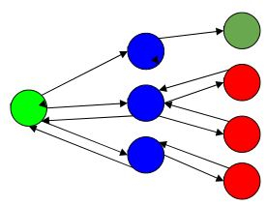
Backtracking
For Example,
Here, Green is the start point, blue is the intermediate point, red are points with no feasible solution, dark green is end solution.
when the algorithm propagates to an end to check if it is a solution or not, if it is then returns the solution otherwise backtracks to the point one step behind it to find track to the next point to find solution.

Slide 23
Backtracking
ALGORITHM
Step 1 − if current_position is goal, return success
Step 2 − else,
Step 3− if current_position is an end point, return failed.
Step 4− else, if current_position is not end point, explore and repeat above steps.

Slide 24
Backtracking
State Space Tree
A State Space Tree is a tree representation of all possible states (solutions) of a problem. It is commonly used in Backtracking and Branch and Bound algorithms.
Definition
A state space tree represents the search process where:
Each node represents a state or partial solution.
Each edge represents a decision or choice.
The root node represents the initial state.
Leaf nodes represent complete solutions or dead ends.
Types of Nodes
Live Node – A node that has been generated but not yet expanded.
E-node (Expansion Node) – The node currently being expanded.
Dead Node – A node that will not be expanded further.

Slide 25
Backtracking
State Space Tree in Backtracking
Explores nodes depth-first.
Prunes non-promising nodes.
Example: N-Queen, Graph Coloring, Hamiltonian Cycle.
State Space Tree in Branch and Bound
Explores nodes based on cost/bound.
Prunes nodes whose bound is worse than the current best solution.
Example: Travelling Salesman Problem (TSP).
Advantages
Systematic search of all possibilities.
Helps visualize the solution process.
Supports pruning to reduce computation.

Slide 26
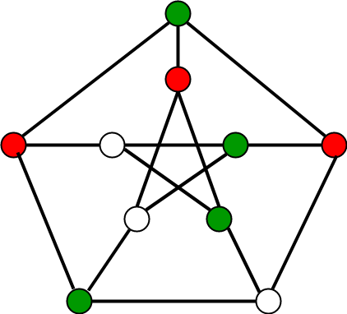
Backtracking
Graph Colouring Problem
Given an undirected graph and a number m, determine if the graph can be coloured with at most m colours such that no two adjacent vertices of the graph are colored with the same color.
Here coloring of a graph means the assignment of colors to all vertices.

Slide 27
Backtracking
Graph Colouring Problem
Input:
A 2D array graph[V][V] where V is the number of vertices in graph and graph[V][V] is adjacency matrix representation of the graph.
A value graph[i][j] is 1 if there is a direct edge from i to j, otherwise graph[i][j] is 0.
An integer m which is the maximum number of colors that can be used
Output:
An array color[V] that should have numbers from 1 to m. color[i] should represent the color assigned to the ith vertex.

Slide 28
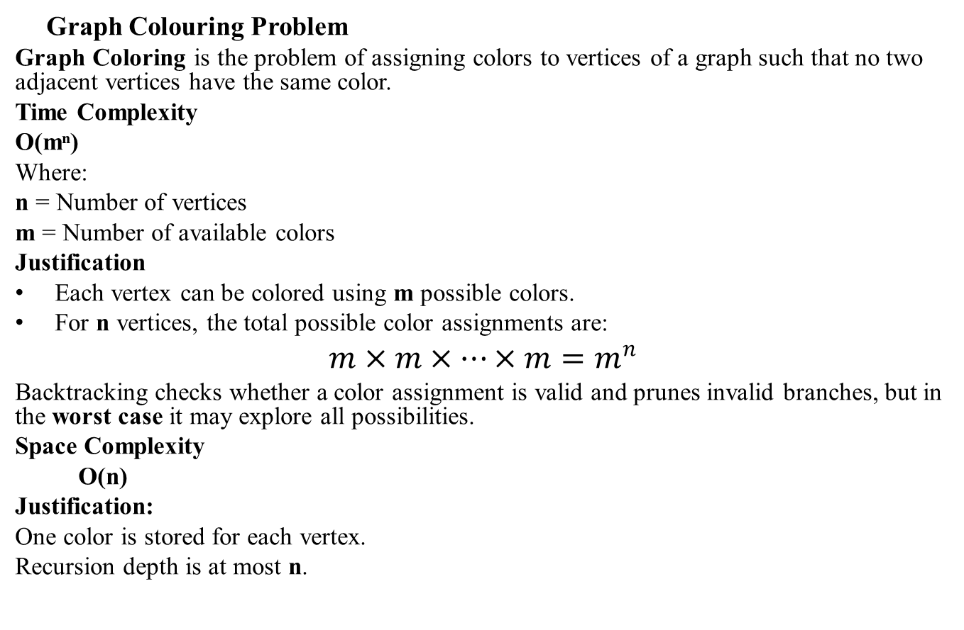
Backtracking
Graph Colouring Problem
Graph Coloring is the problem of assigning colors to vertices of a graph such that no two adjacent vertices have the same color.
Time Complexity
O(mⁿ)
Where:
n = Number of vertices
m = Number of available colors
Justification
Each vertex can be colored using m possible colors.
For n vertices, the total possible color assignments are:
$$m×m×⋯×m=m^{n}$$
Backtracking checks whether a color assignment is valid and prunes invalid branches, but in the worst case it may explore all possibilities.
Space Complexity
O(n)
Justification:
One color is stored for each vertex.
Recursion depth is at most n.

Slide 29
Backtracking
N- Queens Problem
N - Queens problem is to place n - queens in such a manner on an n x n chessboard that no queens attack each other by being in the same row, column or diagonal.
It can be seen that for n =1, the problem has a trivial solution, and no solution exists for n =2 and n =3.
So first we will consider the 4 queens problem and then generate it to n - queens problem.
Given a 4 x 4 chessboard and number the rows and column of the chessboard 1 through 4.

Slide 30
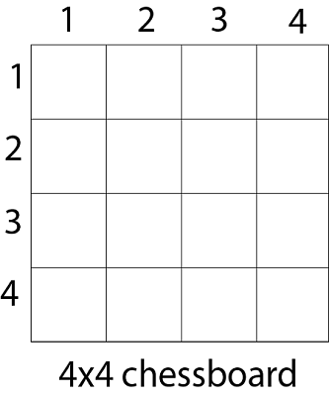
Backtracking
N- Queens Problem
Since, we have to place 4 queens such as q₁ q₂ q₃ and q₄ on the chessboard, such that no two queens attack each other. In such a conditional each queen must be placed on a different row, i.e., we put queen "i" on row "i."

Slide 31
Backtracking
N- Queens Problem
Now, we place queen q₁ in the very first acceptable position (1, 1).
Next, we put queen q₂ so that both these queens do not attack each other.
We find that if we place q₂ in column 1 and 2, then the dead end is encountered.
Thus the first acceptable position for q₂ in column 3, i.e. (2, 3) but then no position is left for placing queen 'q₃' safely.

Slide 32
Backtracking
N- Queens Problem
So we backtrack one step and place the queen 'q₂' in (2, 4), the next best possible solution. Then we obtain the position for placing 'q₃' which is (3, 2).
But later this position also leads to a dead end, and no place is found where 'q₄' can be placed safely.
Then we have to backtrack till 'q₁' and place it to (1, 2) and then all other queens are placed safely by moving q₂ to (2, 4), q₃ to (3, 1) and q₄ to (4, 3).

Slide 33
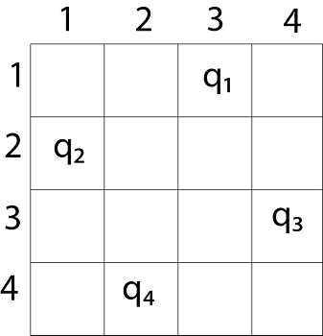
Backtracking
N- Queens Problem
That is, we get the solution (2, 4, 1, 3).
This is one possible solution for the 4-queens problem.
For another possible solution, the whole method is repeated for all partial solutions. The other solutions for 4 - queens problems is (3, 1, 4, 2) i.e.

Slide 34
Backtracking
N- Queens Problem
Fig shows the complete state space for 4 - queens problem. But we can use backtracking method to generate the necessary node and stop if the next node violates the rule, i.e., if two queens are attacking.
It can be seen that all the solutions to the 4 queens problem can be represented as 4 - tuples (x₁, x₂, x₃, x₄) where x_{i} represents the column on which queen "q_{i}" is placed.

Slide 35
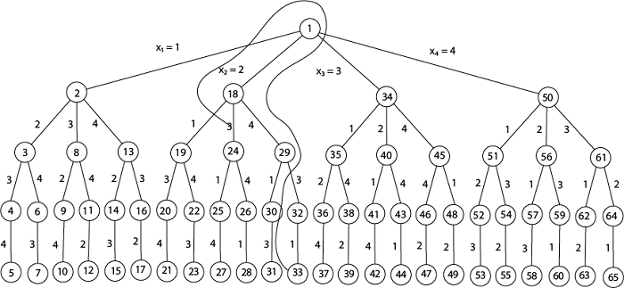
Backtracking
4- Queens Problem

Slide 36
Backtracking
N- Queens Problem
Place (k, i)
{
For j ← 1 to k - 1
do if (x [j] = i)
or (Abs x [j]) - i) = (Abs (j - k))
then return false;
return true;
}
Place (k, i) return true if a queen can be placed in the kth row and ith column otherwise return is false.
x [] is a global array whose final k - 1 values have been set. Abs (r) returns the absolute value of r.

Slide 37
Backtracking
N- Queens Problem
x [] is a global array whose final k - 1 values have been set. Abs (r) returns the absolute value of r.
N - Queens (k, n)
{
For i ← 1 to n
do if Place (k, i) then
{
x [k] ← i;
if (k ==n) then
write (x [1....n));
else
N - Queens (k + 1, n);
}
}

Slide 38
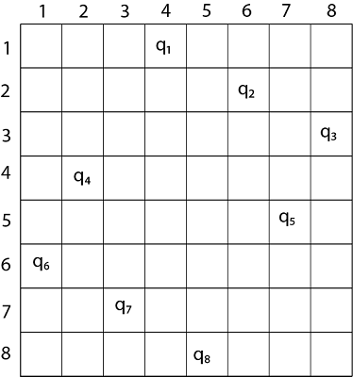
Backtracking
8- Queens Problem
Thus, the solution for 8 -queen problem for (4, 6, 8, 2, 7, 1, 3, 5).
If two queens are placed at position (i, j) and (k, l).
Then they are on same diagonal only if (i - j) = k - l or i + j = k + l.
The first equation implies that j - l = i - k.
The second equation implies that j - l = k - i.
Therefore, two queens lie on the duplicate diagonal if and only if |j-l|=|i-k|

Slide 39

Backtracking
N-Queens Problem (Backtracking)
Time Complexity: O(N!)
Justification:
Place one queen in each row.
For the first row, there are N choices.
For the second row, at most N−1 choices.
For the third row, at most N−2 choices, and so on.
Therefore, the total number of possibilities is:
$$N×\left(N−1\right)×\left(N−2\right)×⋯×1=N!$$
Backtracking prunes invalid positions, but in the worst case it may still explore a factorial number of configurations.
Space Complexity
O(N)
Justification:
Recursion depth = N
One queen stored per row

Slide 40
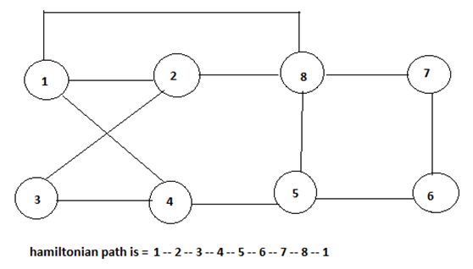
Backtracking
Hamiltonian Cycles
Hamiltonian Path in an undirected graph is a path that visits each vertex exactly once return to initial vertex.
A Hamiltonian cycle (or Hamiltonian circuit) is a Hamiltonian Path such that there is an edge (in the graph) from the last vertex to the first vertex of the Hamiltonian Path.

Slide 41
Backtracking
Algorithm: Backtracking
Steps:
Start from any vertex.
Add a vertex to the path if:
  It is adjacent to the previous vertex.
  It has not already been included in the path.
Repeat until all vertices are included.
Check if the last vertex is connected to the first vertex.
If not, backtrack and try another vertex.

Slide 42

Backtracking
Time Complexity
O(N!)
Justification:
First vertex is fixed.
For the remaining $N−1$vertices, all possible permutations may need to be checked.
$$\left(N−1\right)!≈O\left(N!\right)$$
Space Complexity
O(N)
Justification:
Path array stores N vertices.
Recursion depth is at most N.

Slide 43
Backtracking
Sum of Subsets Problem
Subset sum problem is to find subset of elements that are selected from a given set whose sum adds up to a given number K.
We are considering the set contains non-negative values. It is assumed that the input set is unique (no duplicates are presented).
Here backtracking approach is used for trying to select a valid subset when an item is not valid, we will backtrack to get the previous subset and add another element to get the solution.

Slide 44
Backtracking
Sum of Subsets Problem
Subset sum problem is to find subset of elements that are selected from a given set whose sum adds up to a given number K.
We are considering the set contains non-negative values. It is assumed that the input set is unique (no duplicates are presented).
Here backtracking approach is used for trying to select a valid subset when an item is not valid, we will backtrack to get the previous subset and add another element to get the solution.

Slide 45
Backtracking
Sum of Subsets Problem
Backtracking Algorithm for Subset Sum
Using exhaustive search we consider all subsets irrespective of whether they satisfy given constraints or not. Backtracking can be used to make a systematic consideration of the elements to be selected.
Algorithm
subsetSum(set, subset, n, subSize, total, node, sum)
Input: The given set and subset, size of set and subset, a total of the subset, number of elements in the subset and the given sum.
Output: All possible subsets whose sum is the same as the given sum.
.

Slide 46
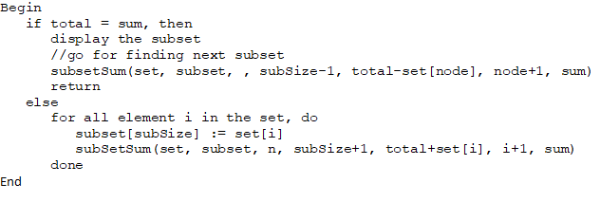
Backtracking
Sum of Subsets Algorithm

Slide 47
Backtracking
Sum of Subsets Example
Given a set S = (3, 4, 5, 6) and X =9. Obtain the subset sum using Backtracking approach.
Solution:
Initially S = (3, 4, 5, 6) and X =9.
S'= (∅)
The implicit binary tree for the subset sum problem is shown in Fig.
The number inside a node is the sum of the partial solution elements at a particular level.
Thus, if our partial solution elements sum is equal to the positive integer 'X' then at that time search will terminate, or it continues if all the possible solution needs to be obtained.

Slide 48
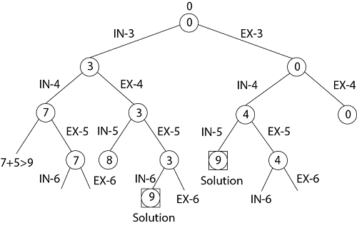
Backtracking
Sum of Subsets Example

Slide 49
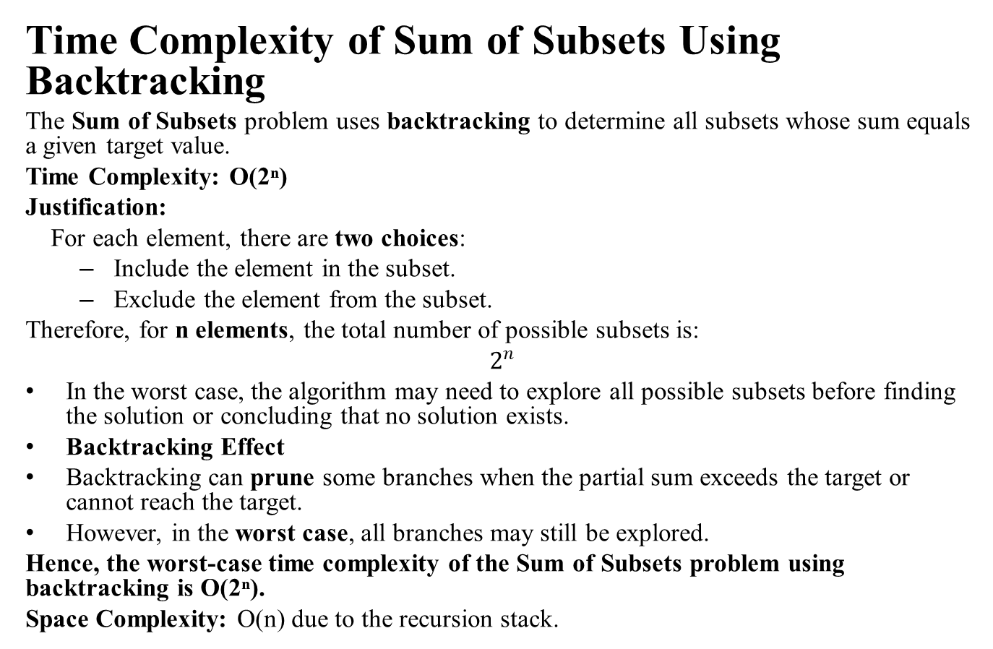
Backtracking
Time Complexity of Sum of Subsets Using Backtracking
The Sum of Subsets problem uses backtracking to determine all subsets whose sum equals a given target value.
Time Complexity: O(2ⁿ)
Justification:
For each element, there are two choices:
  Include the element in the subset.
  Exclude the element from the subset.
Therefore, for n elements, the total number of possible subsets is:
$$2^{n}$$
In the worst case, the algorithm may need to explore all possible subsets before finding the solution or concluding that no solution exists.
Backtracking Effect
Backtracking can prune some branches when the partial sum exceeds the target or cannot reach the target.
However, in the worst case, all branches may still be explored.
Hence, the worst-case time complexity of the Sum of Subsets problem using backtracking is O(2ⁿ).
Space Complexity: O(n) due to the recursion stack.

Slide 50
Backtracking
Sum of Subsets Example
Input: The Set: {10, 7, 5, 18, 12, 20, 15}
The sum Value: 35
Output:
All possible subsets of the given set, where sum of each element for every subsets is same as the given sum value.
{10, 7, 18}
{10, 5, 20}
{5, 18, 12}
{20, 15}

Slide 51
MCQ
Which of the following is/are property/properties of a dynamic programming problem?
a) Optimal substructure
b) Overlapping subproblems
c) Greedy approach
d) Both optimal substructure and overlapping subproblems
If a problem can be broken into subproblems which are reused several times, the problem possesses ____________ property.
a) Overlapping subproblems
b) Optimal substructure
c) Memoization
d) Greedy

Slide 52
MCQ
When dynamic programming is applied to a problem, it takes far less time as compared to other methods that don’t take advantage of overlapping subproblems.
a) True
b) False
Which of the following problems is NOT solved using dynamic programming?
a) 0/1 knapsack problem
b) Matrix chain multiplication problem
c) Edit distance problem
d) Fractional knapsack problem

Slide 53
MCQ
Which of the following problems should be solved using dynamic programming?
a) Mergesort
b) Binary search
c) Longest common subsequence
d) Quicksort
If a problem can be solved by combining optimal solutions to non-overlapping problems, the strategy is called _____________
a) Dynamic programming
b) Greedy
c) Divide and conquer
d) Recursion

Slide 54
MCQ
Which of the problems cannot be solved by backtracking method?
a) n-queen problem
b) subset sum problem
c) hamiltonian circuit problem
d) travelling salesman problem
Backtracking algorithm is implemented by constructing a tree of choices called as?
a) State-space tree
b) State-chart tree
c) Node tree
d) Backtracking tree

Slide 55
MCQ
In what manner is a state-space tree for a backtracking algorithm constructed?
a) Depth-first search
b) Breadth-first search
c) Twice around the tree
d) Nearest neighbour first
The problem of finding a subset of positive integers whose sum is equal to a given positive integer is called as?
a) n- queen problem
b) subset sum problem
c) knapsack problem
d) hamiltonian circuit problem

Slide 56

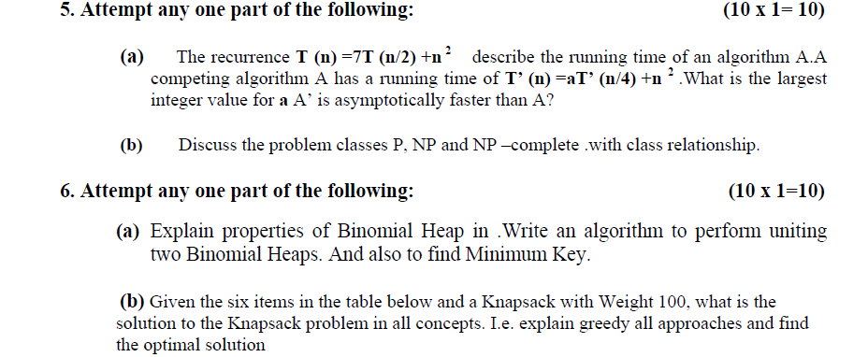
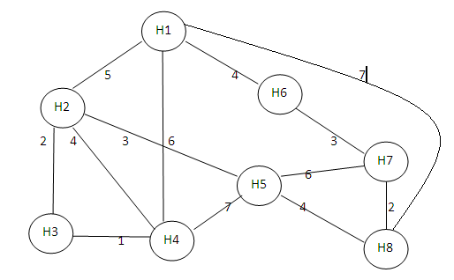
Expected Questions
Solve the problem of travelling salesman problem on following graph and perform operation for each vertex. [CO4]
2. Write Short notes on the following. [CO4] i) Graph Coloring
ii)Sub Set Sum Problem
iii)Hamiltonian Cycle

Slide 57
Expected Questions
3. Find out one optimal solution for following using back tracking.
4*4 chessboard,4 Queen Problem
8*8 chessboard,8 Queen Problem [CO4]
4. Write the difference between the Greedy method and Dynamic programming. [CO4]
Explain the term state space search tree with suitable example. [CO4]
6. Explain Floyd algorithm and also analyze its complexity [CO4]

